Slide 1


Predictive Maintenance of Packaging Conveyors in Food Industry
BATCH:07
THIRUMURUGAN
SUBHIKSHA
SUREN KARTHIK
SHRE HAARAAN A
SAYA SAI KOWSHALYA

Slide 2

Introduction
.
Conveyor systems in the food industry are prone to unexpected mechanical failures. These disruptions slow down packaging operations, leading to production delays.
Traditional maintenance is reactive and often inefficient. We propose a predictive approach using real-time sensor data and ML models.

Slide 3
Project Overview
IR and MPU6050 sensors detect motion and vibration data, which is sent to the cloud.
ML models learn normal behavior and predict faults. Data analytics reveals usage patterns, wear trends, and failure precursors.
Maintenance dashboards and KPIs help schedule servicing proactively, minimizing downtime and enhancing reliability.

Slide 4
Problem Statement
Conveyor belts in food packaging plants suffer from unnoticed wear and tear, causing unexpected breakdowns. This leads to unplanned downtime, loss of productivity, and increased maintenance costs.
The objective is to detect and predict mechanical faults in conveyor belts before failure. We use real-time sensor data and ML algorithms to identify early fault indicators.
To build an intelligent monitoring system using sensor data and machine learning, enabling real-time fault detection and proactive maintenance for reduced downtime.

Slide 5
Proposed Solution
Our system gathers real-time data from sensors attached to conveyor systems. This data is sent to the cloud, where machine learning models analyze it.
When a fault pattern is detected, alerts are triggered instantly. A live dashboard gives operators visibility into conveyor performance. (You can include an architecture diagram on this slide.)

Slide 6
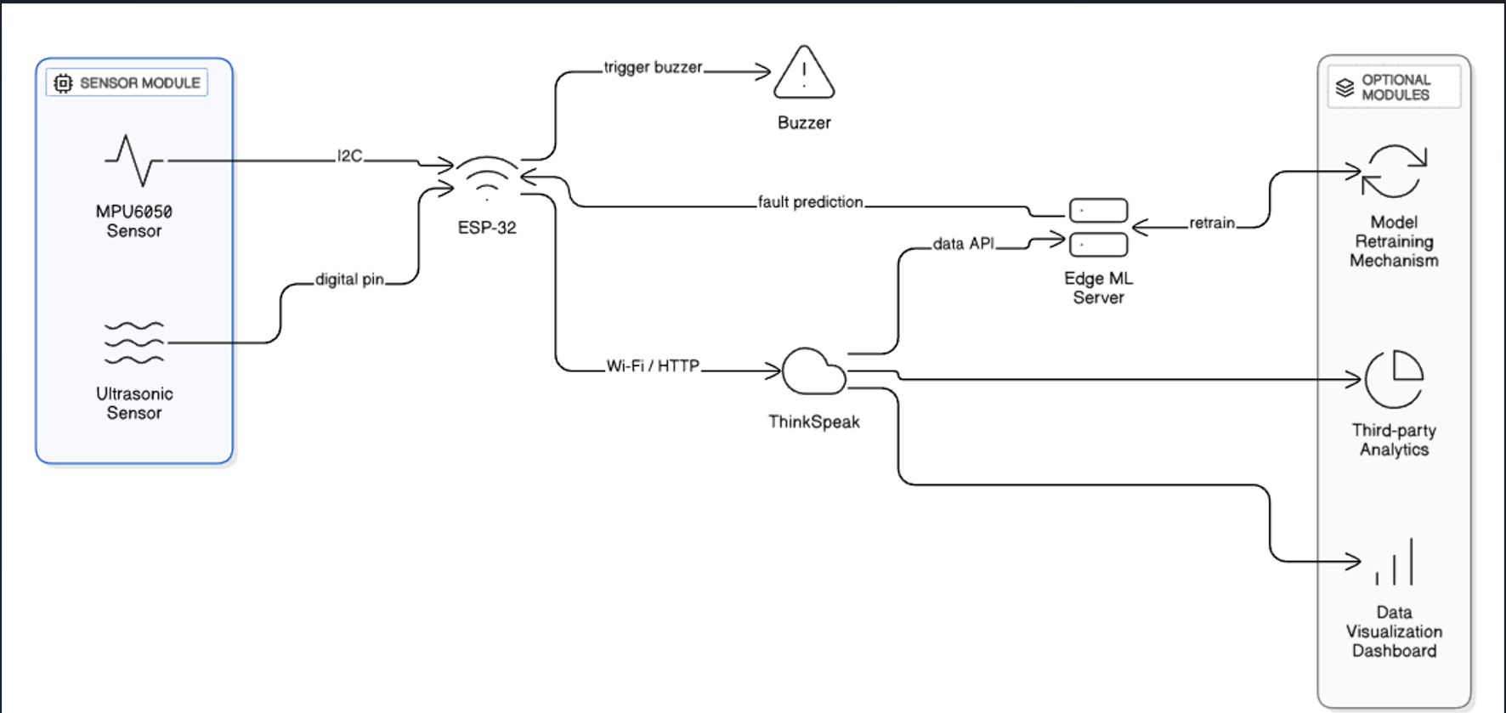
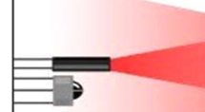
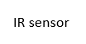
System Design

Slide 7
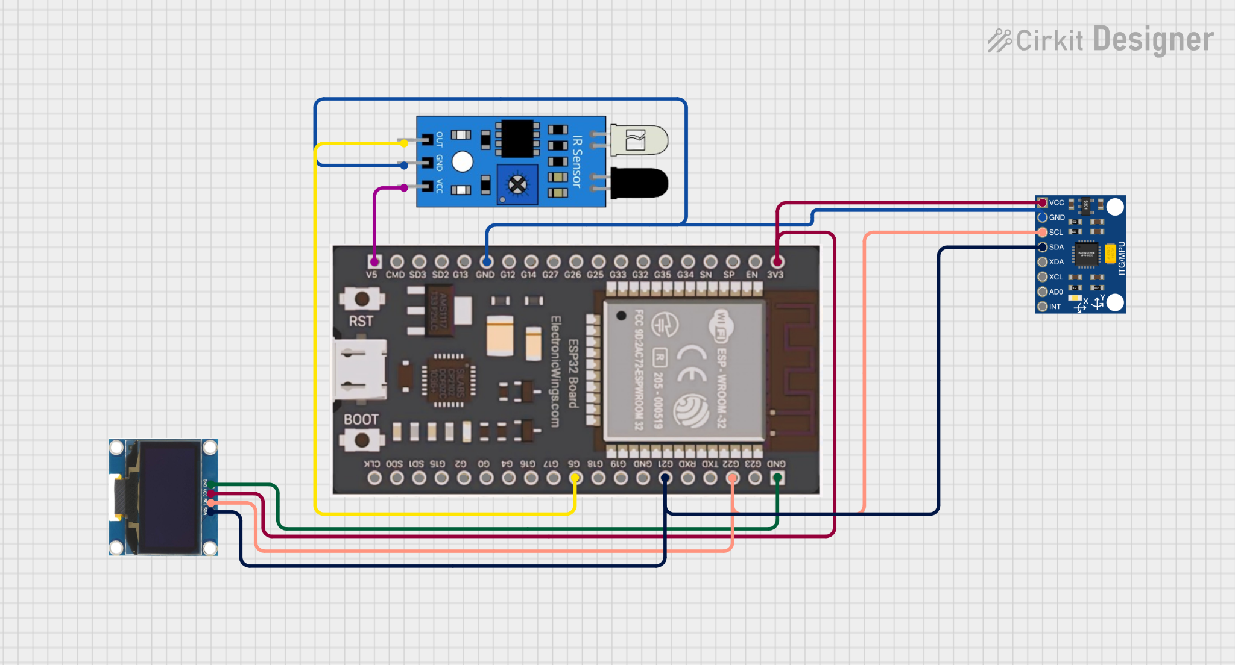
Circuit Diagram

Slide 8
Resources Utilized
Hardware:
ESP 32
IR and MPU6050 sensors
OLED
Software & Tools:
Arduino IDE is used for hardware programming.
Python for ML model development.
Thingspeak for cloud Integration.
Power Bi for Data Analytics.
Datasets/ML Models Used:
The dataset contains labeled real-time sensor data from conveyor operations, and machine learning models like Random Forest are used to detect evolving fault patterns.

Slide 9
Implementation
MPU & IR Sensors were programmed to detect mechanical issues like block and vibration.
Sensor data was transmitted via Wi-Fi and stored in the cloud for analysis.
The obtained dataset was synthesized.
Random forest classifier was trained on the synthesized data.
A web-based dashboard was developed using power Bi for the data analytics.

Slide 10
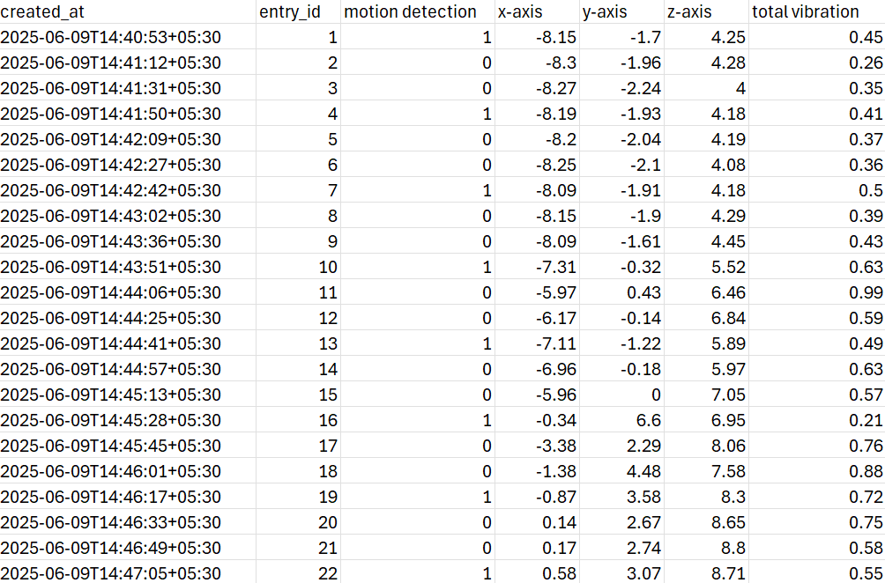
Data received using sensor

Slide 11
ML Model
We used Random Forest because it performs exceptionally well on structured, tabular data without requiring sequence modeling.
It handles missing values and outliers effectively, which suits our dataset characteristics. The model is easy to interpret, especially with its feature importance insights.
Compared to deep learning models like LSTM, Random Forest is faster to train and less prone to overfitting. It also achieved high accuracy and robustness, making it ideal for our classification task.

Slide 12
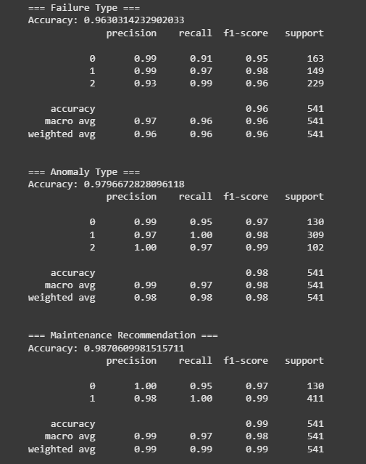
Results
Failure Type:
0- Block
1-Bearing
2-Heat
Maintenance requirement:
0- Maintenance required
1- Supervision Required
Anomaly:
0-Critical
1-Fault
2-Running

Slide 13
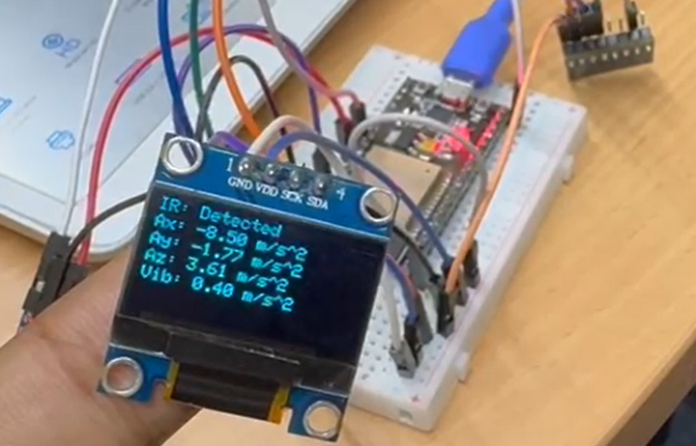
Output

Slide 14
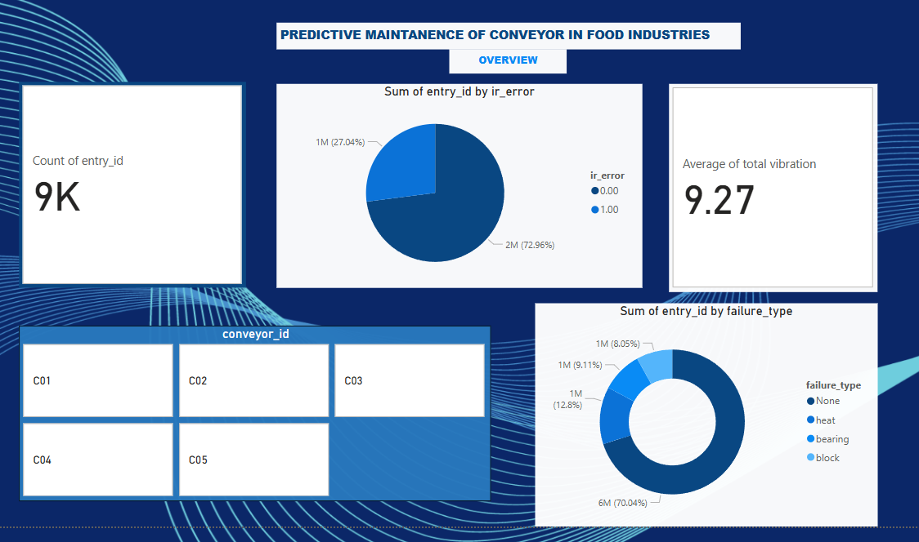
PowerBi

Slide 15
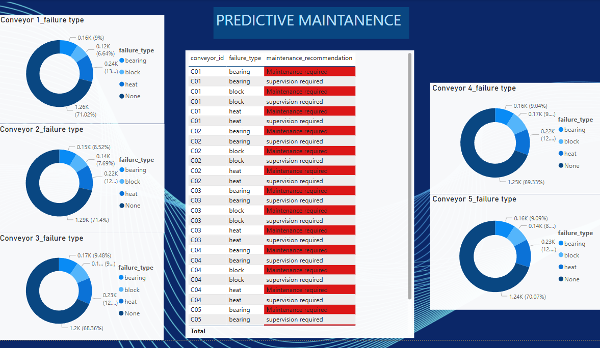

Slide 16
Advantages & Limitations
Advantages: The system provides early fault detection with minimal human intervention. It is low-cost, scalable, and suitable for integration into existing conveyors.
Limitations: Real-time prediction depends on network stability and sensor calibration. The model requires diverse training data covering all possible fault conditions.

Slide 17
Thank you

